Slide 1
NMR spectroscopy
Presented by Jaghdish Battu
Dept.of Chemistry
Avanthi Degree & P.G College

Slide 2
Objectives
Student should gain better understanding of NMR spectroscopy.
Student should gain experience in the acquisition, processing, and displaying NMR data.
Student should gain experience in interpreting NMR data in order to establish structure for unknown organic molecules.
Student should gain understanding in advanced 1Dimensional and 2Dimensional NMR techniques.

Slide 3
Introduction
The Nobel Prize has been awarded twice for work related to NMR. F. Bloch and E.M. Purcell received the Nobel Prize in Physics, in 1952, for the first experimental verifications of the phenomenon, and Prof. R.R. Ernst received the Nobel Prize in Chemistry, in 1991, for the development of the NMR techniques.
Since its discovery 50 years ago, in 1945, it has spread from physics to chemistry, biosciences, material research and medical diagnosis.

Slide 4
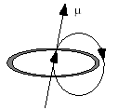
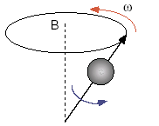
The Physical Basis of the NMR Experiment
Imagine a charge travelling circularily about an axis builds up a magnetic moment
It rotates (spins) about its own axis (the blue arrow) and precesses about the axis of the magnetic field B (the red arrow). The frequency of the precession (ω) is proportional to the strength of the magnetic field:
ω = γ B₀
= magnetogyro ratio
Magnetic field mrasured in Tesla
1 T = 10,000 gauss

Slide 5
Magnetogyric ratio(γ)
The larger the value of the magnetogyric ratio, the larger the
Magnetic moment (μ) of the nucleus and the easier it is to see by NMR spectroscopy.
Energy difference (ΔE) between I_{z} = +1/2 and I_{z} = -1/2.

Slide 6
The Physical Basis of the NMR Experiment:
Nuclear magnetic resonance, or NMR as it is abbreviated by scientists, is a phenomenon which occurs when the nuclei of certain atoms are immersed in a static strong magnetic field and exposed to a second oscillating magnetic field in the form of radiofrequency pulses, it is possible to transfer energy into the spin system and change the state of the system. After the pulse, the system relaxes back to its state of equilibrium, sending a weak signal that can be recorded.

Slide 7
Larmour frequency
Precession: The circular movement of the magnetic moment in the presence of the applied field.
Larmour frequency : The angular frequency of the precessionis related to the external magnetic field strength B₀, by the gyromagnetic ratio γ :
ω₀ = γB₀

Slide 8
Spin quantum number(I)
Nuclear spin is characterized by a spin number, I, which can be zero or some positive integer multiple of 1/2 (e.g. 1/2, 1, 3/2, 2 etc.). Nuclei whose spin number, I= 0 have no magnetic moment(μ);eg. ¹²C and ¹⁶O show no NMR signal. Elements such as ¹H, ¹³C, ¹⁹F and ³¹P have I=1/2, while others have even higher spin numbers:
I=1 ¹⁴N, ²H
I=3/2 ¹¹B, ³⁵Cl, ³⁷Cl, ⁷⁹Br, ⁸¹Br.
As the values for I increase, energy levels and shapes of the magnetic fields become progressively more and more complex.

Slide 9
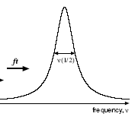
Information in a NMR Spectra
γ-rays x-rays UV VIS IR μ-wave radio
1) Energy E = hυ
h is Planck constant
υ is NMR resonance frequency
10⁻¹⁰ 10⁻⁸ 10⁻⁶ 10⁻⁴ 10⁻² 10⁰ 10²
wavelength (cm)
Observable Name Quantitative Information
Peak position Chemical shifts (δ) δ(ppm) = υ_{obs} –υ_{ref}/υ_{ref} (Hz) chemical (electronic)
environment of nucleus
Peak Splitting Coupling Constant (J) Hz peak separation neighboring nuclei
(intensity ratios) (torsion angles)
Peak Intensity Integral unitless (ratio) nuclear count (ratio)
relative height of integral curve T₁ dependent
Peak Shape Line width Δυ = 1/πT₂ molecular motion
peak half-height chemical exchange
uncertainty principal
uncertainty in energy

Slide 10
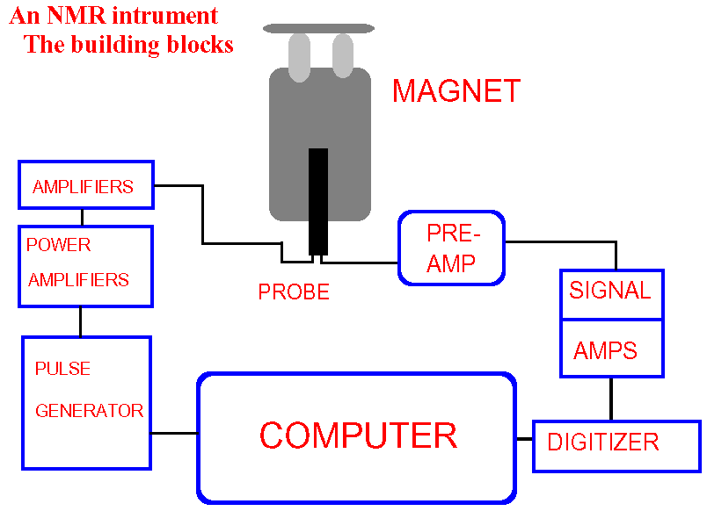
Basic NMR Spectrometer

Slide 11
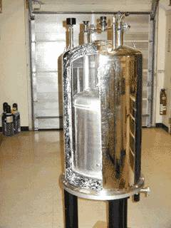
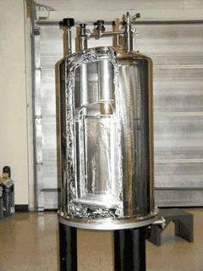
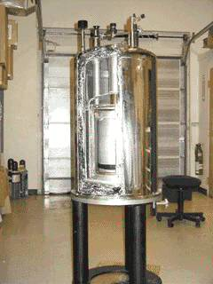
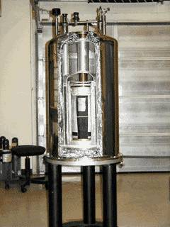
How NMR is achieved
Liq N₂ Liq He Magnet

Slide 12
Nuclear Magnetic Resonance
Sample Preparation
NMR samples are prepared and run in 5 mm glass NMR tubes. Always fill your NMR tubes to the same height with lock solvent
Deuteron resonance serves as lock- signal for the stabilisation of the spectrometer magnetic fieled.

Slide 13
Common NMR solvents
Acetone- d₆ Ethanole- d₆ Acetonitrile- d₃
Formic acid- d₂ Benzene- d₆ Methanole- d₄
Chloroform- d₁ Nitromethane- d₃ Deuteriumoxide-D₂O
Pyridine- d₅ Dichloromethane- d₂ 1,1,2,2- Tetrachloroethane- d₂ Dimethylformamide- d₇ Tetrahydrofurane- d₈ Dimethylsulfoxide- d₆
Toluene- d₈ 1,4- Dioxane- d₈ Trifluoroacetic acid- d₁
NMR solvents are used as reference peaks
to adjust the ppm values in the spectrum
relative to TMS (tetramethyl silane)

Slide 14
The Proton NMR
Stereochemical Equivalent/Non-equivalent Protons
Chemical Shift
Spin Coupling
NMR Splitting of Signals
Coupling Constant( J )

Slide 15
Eqivalent and Non-Equivalent protons

Slide 17
Chemical Shift
The chemical shift of a nucleus is the difference between the resonance frequency of the nucleus and a standard, relative to the
standard. This quantity is reported in ppm and given the symbol delta, δ.
δ = (n - n_{REF}) x10⁶ / n_{REF}

Slide 18
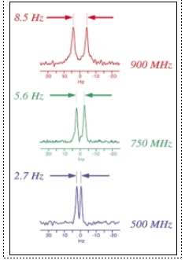
The NMR scale (δ, ppm)
Chemical shift (δ) is a relative scale so it is independent of B_{o}. Same chemical shift at 100 MHz vs. 900 MHz magnet
IMPORTANT: absolute frequency is field dependent (ν = γ B_{o} / 2π)
At higher magnetic fields an NMR spectra will exhibit the same chemical shifts but with higher resolution because of the higher frequency range.

Slide 19
Chemical Shift Trends
For protons, ~ 15 ppm:
Alcohols, protons α
to ketones
Aromatics
Amides
Acids
Aldehydes
Olefins
Aliphatic
ppm
15
10
7
5
2
0
TMS

Slide 20
Chemical Shift Trends
For carbon, ~ 220 ppm:
Aromatics,
conjugated alkenes
C=O in
ketones
Aliphatic CH₃,
CH₂, CH
Olefins
ppm
210
150
100
80
50
0
TMS
C=O of Acids,
aldehydes, esters
Carbons adjacent to
alcohols, ketones

Slide 21
Spin-Spin Coupling
Nuclei which are close to one another exert an influence on each other's effective magnetic field. This effect shows up in the NMR spectrum when the nuclei are nonequivalent. If the distance between non-equivalent nuclei is less than or equal to three bond lengths, this effect is observable. This effect is called spin-spin coupling or J coupling.

Slide 22
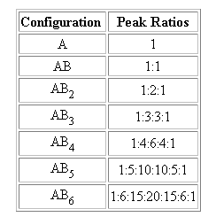
Spin-Spin Coupling
For the next example, consider a molecule with spin 1/2 nuclei, one type A and type B
This series is called Pascal's triangle and can be calculated from the coefficients of the expansion of the equation (x+1)^{n}

Slide 24
Coupling Constants
Energy level of a nuclei are affected by covalently-bonded neighbors spin-states
1
H
1
H
1
H
1
3
C
three-bond
one-bond
Spin-States of covalently-bonded nuclei want to be aligned.
+J/4
ββ
J (Hz)
I
S
-J/4
αβ
βα
S
I
I S
+J/4
αα
The magnitude of the separation is called coupling constant (J) and has units of Hz.

Slide 25
Coupling Constants
IMPORTANT: Coupling constant pattern allow for the identification of bonded nuclei.
Multiplets consist of 2nI + 1 lines
I is the nuclear spin quantum number (usually 1/2) and
n is the number of neighboring spins.
The ratios between the signal intensities within multiplets are governed by the numbers of Pascals triangle.
Configuration | Peak Ratios
A | 1
AX | 1:1
AX₂ | 1:2:1
AX₃ | 1:3:3:1
AX₄ | 1:4:6:4:1

Slide 26
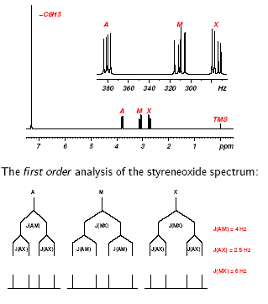
Coupling Constants

Slide 27
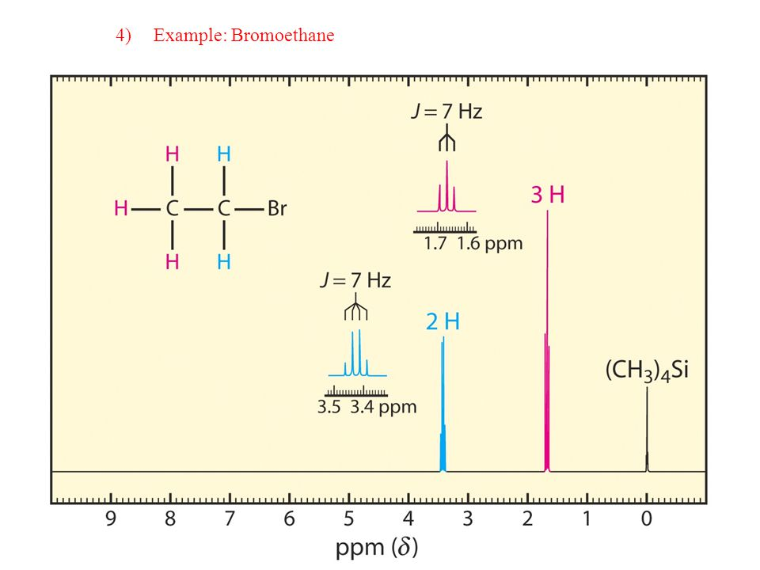
NMR Spectrum of Ethyl bromide

Slide 29
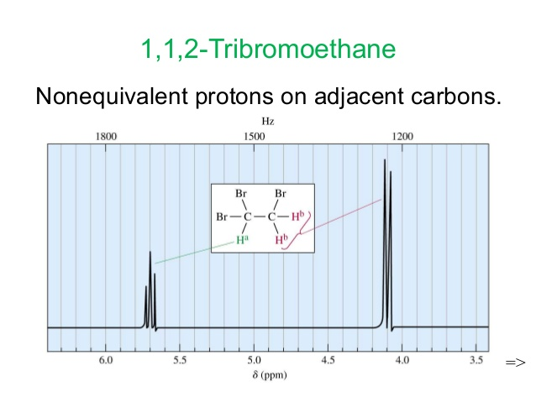
NMR Spectrum of 1,1,2-tribromo ethane

Slide 30
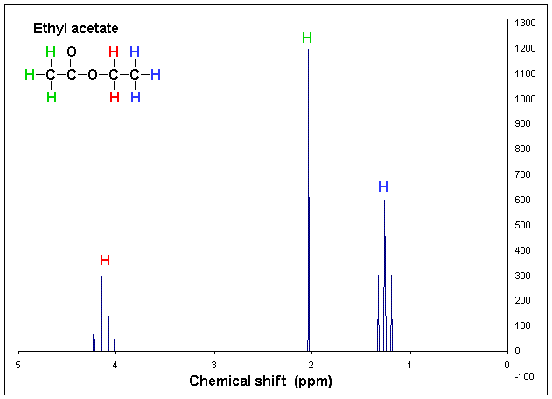
NMR Spectrum of Ethyl acetate

Slide 31
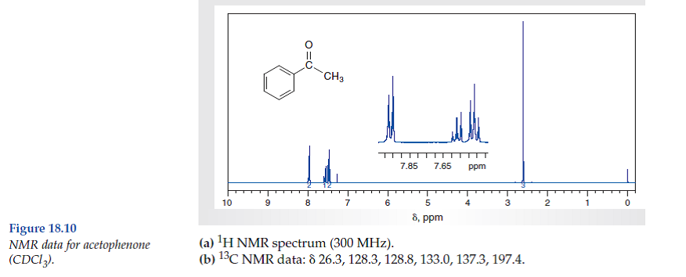
NMR Spectrum of Acetophenone

Slide 32
THANK YOU

