Slide 1
Presented by Jaghdish Battu
MASS SPECTROMETRY
Dept.of Chemistry
Avanthi Degree & P.G College

Slide 2
Mass Spectrometry
Introduction
General overview
Mass Spectrometry is the generation, separation and characterization of gas phase ions according to their relative mass as a function of charge
Previously, the requirement was that the sample be able to be vaporized (similar limitation to GC), but modern ionization techniques allow the study of such non-volatile molecules as proteins and nucleotides
The technique is a powerful qualitative and quantitative tool, routine analyses are performed down to the femtogram (10⁻¹⁵ g) level and as low as the zeptomole (10⁻²¹ mol) level for proteins
Of all the organic spectroscopic techniques, it is used by more divergent fields – metallurgy, molecular biology, semiconductors, geology, archaeology than any other

Slide 3
Mass Spectrometry
I. The Mass Spectrometer
General Schematic
A mass spectrometer needs to perform three functions:
Creation of ions – the sample molecules are subjected to a high energy beam of electrons, converting some of them to ions
Separation of ions – as they are accelerated in an electric field, the ions are separated according to mass-to-charge ratio (m/z)
Detection of ions – as each separated population of ions is generated, the spectrometer needs to qualify and quantify them
The differences in mass spectrometer types are in the different means to carry out these three functions
Common to all is the need for very high vacuum (~ 10⁻⁶ torr), while still allowing the introduction of the sample

Slide 4
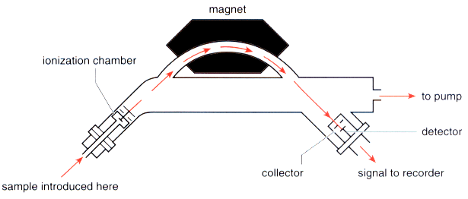
Mass Spectrometry
The Mass Spectrometer
Single Focusing Mass Spectrometer
A small quantity of sample is injected and vaporized under high vacuum
The sample is then bombarded with electrons having 25-80 eV of energy
A valence electron is “punched” off of the molecule, and an ion is formed

Slide 5
Mass Spectrometry
The Mass Spectrometer
The Single Focusing Mass Spectrometer
Ions (+) are accelerated using a (-) anode towards the focusing magnet
At a given potential (1 – 10 kV) each ion will have a kinetic energy:
½ mv² = eV
As the ions enter a magnetic field, their path is curved; the radius of the curvature is given by:
r = mv
eH
If the two equations are combined to factor out velocity:
m/e = H²r²
2V
m = mass of ion
v = velocity
V = potential difference
e = charge on ion
H = strength of magnetic field
r = radius of ion path

Slide 6
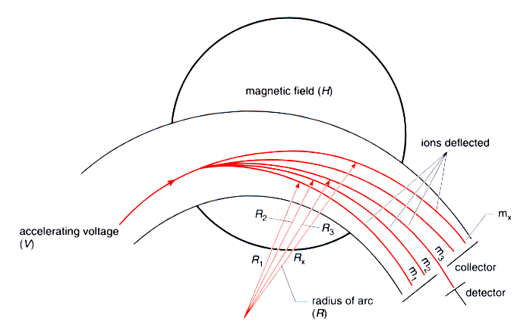
Mass Spectrometry
The Mass Spectrometer
Single Focusing Mass Spectrometer
At a given potential, only one mass would have the correct radius path to pass through the magnet towards the detector
“Incorrect” mass particles would strike the magnet

Slide 7
Mass Spectrometry
The Mass Spectrometer
Single Focusing Mass Spectrometer
By varying the applied potential difference that accelerates each ion, different masses can be discerned by the focusing magnet
The detector is basically a counter, that produces a current proportional to the number of ions that strike it
This data is sent to a computer interface for graphical analysis of the mass spectrum

Slide 8
Mass Spectrometry
II. The Mass Spectrum
A. Determination of Molecular Mass
When a M+ peak is observed it gives the molecular mass – assuming that every atom is in its most abundant isotopic form
Remember that carbon is a mixture of 98.9% ¹²C (mass 12), 1.1% ¹³C (mass 13) and <0.1% ¹⁴C (mass 14)
We look at a periodic table and see the atomic weight of carbon as 12.011 – an average molecular weight
The mass spectrometer, by its very nature would see a peak at mass 12 for atomic carbon and a M + 1 peak at 13 that would be 1.1% as high

Slide 9
Mass Spectrometry
The Mass Spectrum
Determination of Molecular Mass
Some molecules are highly fragile and M+ peaks are not observed – one method used to confirm the presence of a proper M+ peak is to lower the ionizing voltage – lower energy ions do not fragment as readily
Three facts must apply for a molecular ion peak:
The peak must correspond to the highest mass ion on the spectrum excluding the isotopic peaks
The ion must have an odd number of electrons – usually a radical cation
The ion must be able to form the other fragments on the spectrum by loss of logical neutral fragments

Slide 10
Mass Spectrometry
II. The Mass Spectrum
Determination of Molecular Mass
The Nitrogen Rule is another means of confirming the observance of a molecular ion peak
If a molecule contains an even number of nitrogen atoms (only “common” organic atom with an odd valence) or no nitrogen atoms the molecular ion will have an even mass value
If a molecule contains an odd number of nitrogen atoms, the molecular ion will have an odd mass value
If the molecule contains chlorine or bromine, each with two common isotopes, the determination of M+ can be made much easier, or much more complex as we will see

Slide 11
Mass Spectrometry
III. The Mass Spectrum and Structural Analysis
Inferences from Isotopic Ratios
For molecules that contain Cl or Br, the isotopic peaks are diagnostic
In both cases the M+2 isotope is prevalent:
³⁵Cl is 75.77% and ³⁷Cl is 24.23% of naturally occurring chlorine atoms
⁷⁹Br is 50.52% and ⁸¹Br is 49.48% of naturally occurring bromine atoms
If a molecule contains a single chlorine atom, the molecular ion would appear:
M⁺
The M+2 peak would be 24% the size of the M⁺
if one Cl is present
relative abundance
M+2
m/e

Slide 12
Mass Spectrometry
The Mass Spectrum and Structural Analysis
Inferences from Isotopic Ratios
For molecules that contain Cl or Br, the isotopic peaks are diagnostic
b) If a molecule contains a single bromine atom, the molecular ion would appear:
c) The effects of multiple Cl and Br atoms is additive – your text has a complete table of the combinations possible with 1-3 of either atom
d) Sulfur will give a M+2 peak of 4% relative intensity and silicon 3%
M⁺
M+2
The M+2 peak would be about the size of the M⁺
if one Br is present
relative abundance
m/e

Slide 13
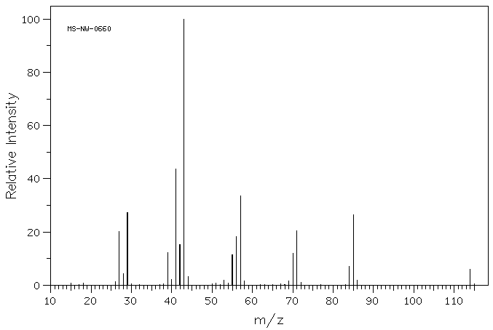
Mass Spectrometry
The Mass Spectrum
Presentation of data
The mass spectrum is presented in terms of ion abundance vs. m/e ratio (mass)
The most abundant ion formed in ionization gives rise to the tallest peak on the mass spectrum – this is the base peak
base peak, m/e 43

Slide 14
Mass Spectrometry
The Mass Spectrum
Presentation of data
All other peak intensities are relative to the base peak as a percentage
If a molecule loses only one electron in the ionization process, a molecular ion is observed that gives its molecular weight – this is designated as M⁺ on the spectrum
M⁺, m/e 114

Slide 15
Mass Spectrometry
The Mass Spectrum
Presentation of data
In most cases, when a molecule loses a valence electron, bonds are broken, or the ion formed quickly fragment to lower energy ions
The masses of charged ions are recorded as fragment ions by the spectrometer – neutral fragments are not recorded !
fragment ions

Slide 16
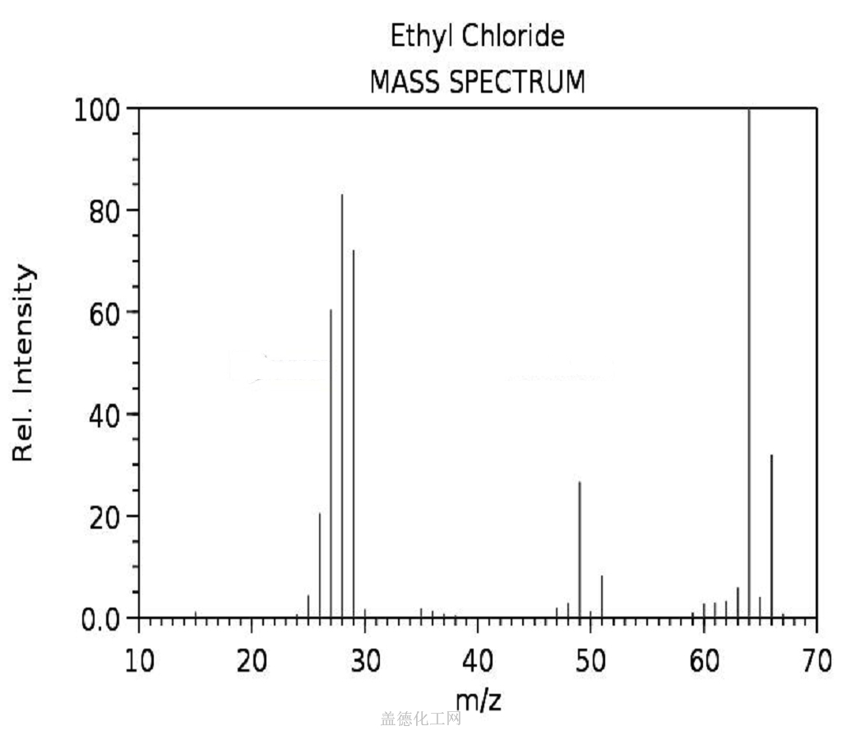
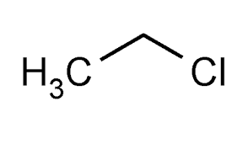
M+
Base peak ,m/e =28
M+2
Molecular ion, m/z =64

Slide 17
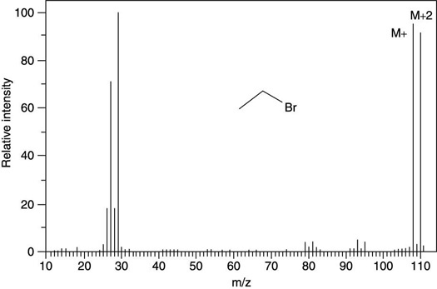
Mass spectrum of Ethyl bromide

Slide 18
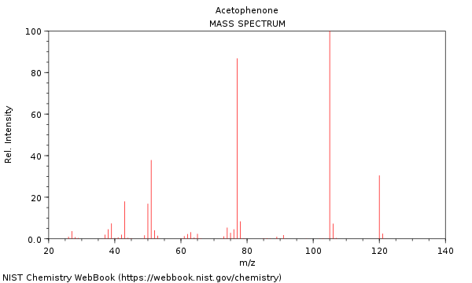
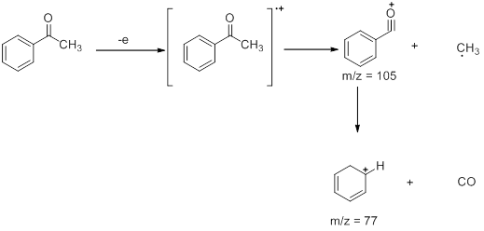
Base peak at m/z=105
Molecular ion at m/z=120

Slide 19
THANK YOU

