Slide 1
Business organisation Unit 1
Introduction

Slide 2
Meaning and Definition of Business
The word business literally means a state of being busy. It may be defined as an activity concerned with the production and exchange of goods and services with the objective of earning profits.
Definition of business:
According to LH Haney “Business may be defined as human activity directed towards providing or acquiring wealth through buying and selling of goods “.
According to Wheeler “An institution organized and operated to provide goods and services to the society under the incentive of private gain”.

Slide 3
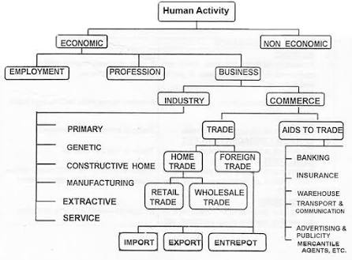
Types of Human Activities:

Slide 4
Features of business
Entrepreneur
Economic activity
Exchange of goods and services
Profit Motive
Risk and Uncertainty
Continuity of transactions
Creation of Utility
Organization
Financing
Consumer satisfaction
Satisfying social needs

Slide 5
Functions Of Business
Functions of Business
Production
Research & Development
Accounting
Marketing
Finance
Personnel

Slide 6
Functions of business
Production function: It involves conversion of raw materials into finished goods and services.
Marketing Function: it involves activities ranging from getting goods from producer and sending them to ultimate consumer. It involves development of marketing mix.
Personnel function: it involves obtaining and maintaining capable and effective workforce, motivating the employees , developing the employees etc..

Slide 7
Continuation of functions of business
Finance Function: Finance function of business is basically responsible for three decisions and their proper implementation, viz.,
(i) investment decisions (financial planning, capital budgeting, etc.)
(ii) Financial decisions (capital structure—fixed and working; short and long-term and
(iii) dividend decisions.
Research and Development: R&D are necessary for every business organisation to make itself up to the date with the changing environment of the market and society. It facilitates to develop the new design, model, size of the product to satisfy the customers.
Accounting Function : Plans and manages financial resources and maintains records and information related to businesses’ finances.

Slide 8
 |  |  |  | Objectives of business
Economic |  |  | Human |  |  | Social |  |  | organic |  |  | National
1. profit earning |  |  | 1. welfare of employees |  |  | 1. Availability of goods |  |  | 1. survival |  |  | 1. Helping national effort
2. Production of goods |  |  | 2. satisfaction of consumers |  |  | 2. supply of quality goods |  |  | 2. Growth |  |  | 2. development of small entrepreneurs
3. creation of markets |  |  | 3. satisfaction of shareholders |  |  | 3. co-operation with the government |  |  | 3. Earn recognition and prestige |  |  | 3. National self sufficiency and export development
4. Technological improvements |  |  |  |  |  | 4. creation of employment |  |  |  |  |  | 4. Development of skilled personnel
 |  |  |  |  |  | 5. utilizing natural resources

Slide 9
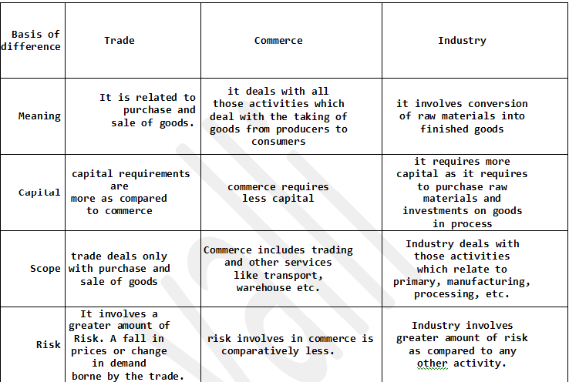
Differences between Industry, Trade & Commerce

Slide 10
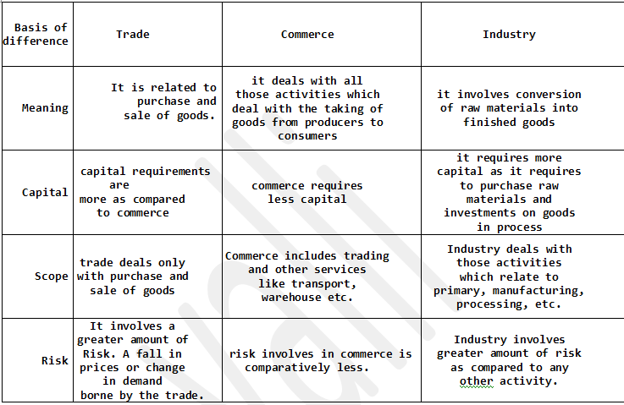
Differences Between Trade and Aids to Trade

Slide 11
Steps to start a new Business Enterprise
Determination of Objectives
Selection of business activity
Size of business Unit
Form of business enterprise
Location of Business
Financial Planning
Selection of Technology
Procedural and Legal Formalities
Building Internal Organisation
Manpower Planning
Tax Planning
Launching Business Enterprise

Slide 12
SOCIAL RESPONSIBILITY OF BUSINESS

Slide 13
The social responsibility of business means various obligations or responsibilities or duties that a business-organization has towards the society within which it exists and operates from.
Social Responsibility of Business Towards…..
Employees or workers
Local Community
Environment
General Public
Consumers or Customers
Government OR its administrative Body

