Slide 1
APPLICATION OF PARTIAL DIFFERENTIATION
RITU DAVE
DEPARTMENT OF MATHEMATICS

Slide 2
Tangent Planes and Linear Approximations
Suppose a surface S has equation z = f (x, y), where f has continuous first partial derivatives, and let P(x₀, y₀, z₀) be a point on S. Let C₁ and C₂ be the two curves obtained by intersection the vertical planes y = y₀ and x = x₀ with the surface. Thus, point P lies on both C₁ and C₂. Let T₁ and T₂ be the tangent lines to the curves C₁ and C₂ at point P. Then the tangent plane to the surface S at point P is defined to be the plane that contains both tangent lines T₁ and T₂.

Slide 3
Tangent Planes and Linear Approximations
Suppose a surface S has equation z = f(x, y), where f
has continuous first partial derivatives.
Let P(x₀, y₀, z₀) be a point on S.
We know from Equation that any plane passing through the point
P(x₀, y₀, z₀) has an equation of the form
z − z₀ = f _{x} (x₀ , y₀ ) (x − x₀ ) + f _{y} (x₀ , y₀ ) ( y − y₀ )

Slide 4
LINEAR APPROXIMATION AND LINEARIZATION
The linearization of f at (a, b) is the linear functions whose graph is the tangent plane, namely
L(x, y) = f (a, b) + f_{x} (a, b)(x − a) + f _{y} (a, b)( y − b)
The approximation
f (x, y) ≈ f (a, b) + f _{x} (a, b)(x − a) + f _{y} (a, b)( y − b)
is called the linear approximation or tangent plane approximation of f at (a, b).

Slide 5
LINEAR APPROXIMATION AND LINEARIZATION
Recall that Δx and Δy are increments of x and y, respectively. If z = f (x, y) is a function of two variables, then Δz, the increment of z is defined to be
Δz = f (x + Δx, y + Δy) − f (x, y)
If z = f (x, y), then f is differentiable at (a, b) if Δz can be expressed in the form
where ε₁ and ε₂ → 0 as (Δx, Δy) → (0, 0).

Slide 6
LINEAR APPROXIMATION AND LINEARIZATION
Theorem: If the partial derivatives f_{x} and f_{y}
exist
near (a, b) and are continuous at (a, b), then f is differentiable at (a, b).
For a differentiable function of two variables, z = f (x, y), we define the differentials dx and dy to be independent variables. Then the differential dz, also called the total differential, is defined by
dz = f (a, b) dx + f (a, b) dy = ^{∂z} dx + ^{∂z} dy
x y
∂x ∂y

Slide 7
LINEAR APPROXIMATION AND LINEARIZATION
For a function of three variables, w = f (x, y, z):
1. The linear approximation at (a, b, c) is
f (x, y, z) ≈ f (a, b, c) + f _{x} (a, b, c)(x − a) + f _{y} (a, b, c)( y − b) + f _{z} (a, b, c)(z − c)
2. The increment of w is
Δw = f (x + Δx, y + Δy, z + Δz) − f (x, y, z)
3. The differential dw is
dw = ^{∂w} dx + ^{∂w} dy + ^{∂w} dz
∂x ∂y ∂z

Slide 8
TAYLOR’s EXPANSIONS
Let a function f ( x) be given as the sum of a power series in the convergence interval of the power series
∞
f ( x ) = ∑ a ( x − x
₎n
n
0
n =0
Then such a power series is unique and its
coefficients are given by the formula
( )
( )
f
n
x
a =
0

n
n!

Slide 9
TAYLOR’s EXPANSIONS
If a function f ( x) has derivatives of all orders at x_{0,} then we can formally write the corresponding Taylor series
f '( x₀ ) f ''( x₀ ) f '''( x₀ )
f ( x) ≈ f ( x₀ ) +
( x − x₀ ) + ( x − x₀ ) + ( x − x₀ ) +
2 3
1! 2! 3!
The power series created in this way is then called the Taylor series of the function f ( x) . A Taylor series for x₀ = 0 is called MacLaurin series.

Slide 10
TAYLOR’s EXPANSIONS
There are functions f (x)
whose formally generated Taylor series do not converge to it.
A condition that guarantees that this will not happen says that
the derivatives of f (x) are all uniformly bounded
in a neighbourhood of x₀.

Slide 11
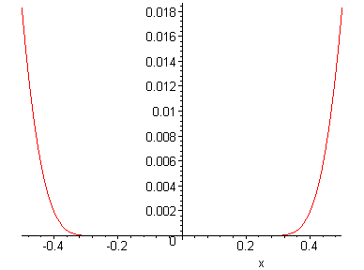
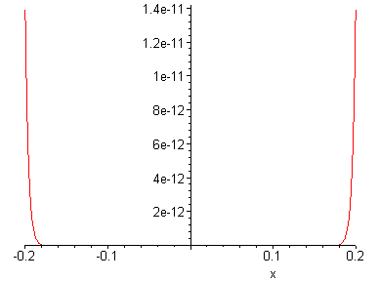
TAYLOR’s EXPANSIONS
There are functions with a Taylor series that, as a power series, converges to quite a different function as the following example shows:
₋ 1
f ( x) = e f (0) = 0
Example
_{x}2
for x ≠ 0,

Slide 12
TAYLOR’s EXPANSIONS
x ≠ 0
⎛
₋ 1 ⎞
d ⎜ e
_{x}2
⎟
⎝ ⎠
dx
2
₋ 1
2
f '( x) =
=
_{x}2
_{x}3
e =
1
x³e^{x2}
and for x = 0:
1
x
₋ 1
_{x}2
f '( x) = lim
e − 0
1
t
1
= lim
= lim
= lim
= lim
= 0
x→0
x
x→0
1
x→0
1
t →∞ _{e}^{t}
2
t →∞ _{2te}^{t}
2
xe^{x}
2
_{e}x
2

Slide 13
TAYLOR’s EXPANSIONS
In a similar way, we could also show that
0 = f (0) = f '(0) = f ' (0) = = f ^{(k )} (0) =
This means that the Taylor series corresponding to f (x) converges to a
constant function that is equal to zero at all points. But clearly,
for
any .
₋ 1
_{x}2
x ≠ 0
e ≠ 0

Slide 14
TAYLOR’s EXPANSIONS
Taylor series of some functions:
_{x}2 _{x}3
x
x
e = 1+
+ + +
1! 2! 3!
_{x}3
_{x}5 _{x}7
sin x = x −
+ − +
3! 5! 7!
_{x}2
_{x}4 _{x}6
cos x = 1−
+ − +
2! 4! 6!
_{x}2 _{x}3 _{x}4
ln (1+ x) = x −
+ − +
2 3 4

Slide 15
Maxima and Minima
The Least and the Greatest
Many problems that arise in mathematics call for finding the largest and smallest values that a differentiable function can assume on a particular domain.
There is a strategy for solving these applied problems.

Slide 16
Maxima and Minima
The Max-Min Theorem for Continuous Functions
If f is a continuous function at every point of a closed interval [a.b], then f takes on a minimum value, m, and a maximum value, M, on [a,b].
In other words, a function that is continuous on a closed interval takes on a maximum and a minimum on that interval.

Slide 17
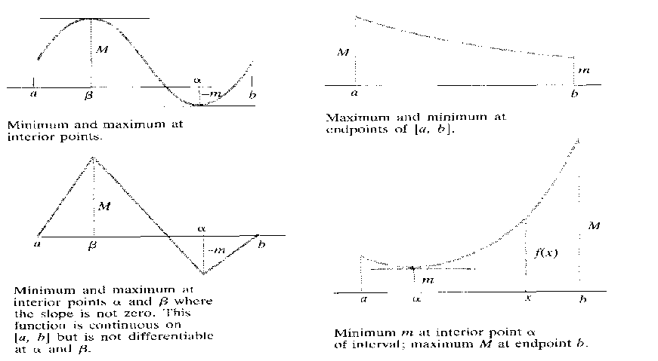
Maxima and Minima
The Max-Min Theorem, Graphically

Slide 18
Maxima and Minima
Strategy for Max-Min Problems
The main problem is setting up the equation:
Draw a picture. Label the parts that are important for the problem. Keep track of what the variables represent.
Use a known formula for the quantity to be maximized or minimized.
Write an equation. Try to express the quantity that is to be maximized or minimized as a function of a single variable, say y=f (x). This may require some algebra and the use of information from the problem.

Slide 19
Maxima and Minima
Find an interval of values for this variable. You need to be mindful of the domain based on restrictions in the problem.
Test the critical points and the endpoints. The extreme value of f will be found among the values f takes at the endpoints of the domain and at the points where the derivative is zero or fails to exist.
List the values of f at these points. If f has an absolute maximum or minimum on its domain, it will appear on the list. You may have to examine the sign pattern of the derivative or the sign of the second derivative to decide whether a given value represents a max, min or neither.

Slide 20
LAGRANGE METHOD
Many times a stationary value of the function of several variables which are not all independent but connected by some relationship is needed to be known. Generally, we do convert the given functions to the one, having least number of independent variables with the help of these relations, then it solved. But this not always be necessary to solve such functions using this ordinary method, and when this procedure become impractical, Lagrange’s method proves to be very convenient, which is explained in the ongoing lines.

Slide 21
LAGRANGE METHOD
Let be a function of three variables which are connected by the relation
For u to be have stationary value, it is necessary that
Also the differential of the relationship function

Slide 22
LAGRANGE METHOD
Multiply (2) by parameter λ and add to (1). Then we obtain the expression
To satisfy this equation the components of the expression need to be equal to zero, i.e.
This three equations together with the relationship function i.e. will determine the value of and λ for which u is stationary.

Slide 23
THANK YOU

