Slide 1
Health Promoting Drugs

Slide 2
Introduction
Drugs or medicine which enhance health are called health promoting drugs
Drugs create a positive impact on disease prevention and health promotion
It is difficult for internet users to distinguish between material promoting drugs and non promoting drugs

Slide 3
Sources
Bio active compounds for food and pharma industry
Marine organisms – One of the most important source
Animals
Micro organisms
Marine bio active compounds are safer compare to syntactic drugs

Slide 4
Nutrition
Nutrition - The process of eating right kind of food for proper growth and health
Nutrients – A food or other substance that provide energy or building material for the survival, normal metabalism and growth of a living organism
Deficiency – The inadequate uptake of any thing is called deficiency

Slide 5
Deficiency disorders
Shortage of intake of essential nutrients through diet
Most of the dietary deficiency diseases are caused due to absence of proteins, vitamins and minerals in the diet
Micro nutrients which are required in smaller quantities viz Na, Ca, Cu, Zn
Macro nutrients which are required in greater quantities – N, K, Ca, Mg, P and S
Trace elements required in very small quantities expressed in PPM - Fe, Mo, Ni, Se, Cr

Slide 6
Deficiency Disorders
Deficiency disorders in humans are directly or indirectly caused by a lack of essential nutrients in the diet
Most foods contain a mix of some or all of the nutrient classes
Some nutrients are required on regular basis while others needed less frequently
Poor health can be caused by an imbalance of nutrients, whether an excess or deficiency

Slide 7
Micro nutrients
Called micronutrients because they are needed only in minuscule amounts
Micro nutrients enable the body to produce enzymes, hormones and other substances essential for proper growth and development
Iodine, Fe, vitamin A and iron are most important
Iodine deficiency is one of the main cause of impaired cognitive development in children
Vitamin A deficiency is the leading cause of preventable blindness in children and increases the risk of disease and death from severe infections
In pregnant women VAD causes night blindness and may increase the risk of maternal mortality
Iron deficiency leads to Anemia

Slide 8
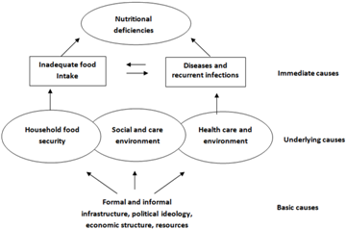

Slide 9
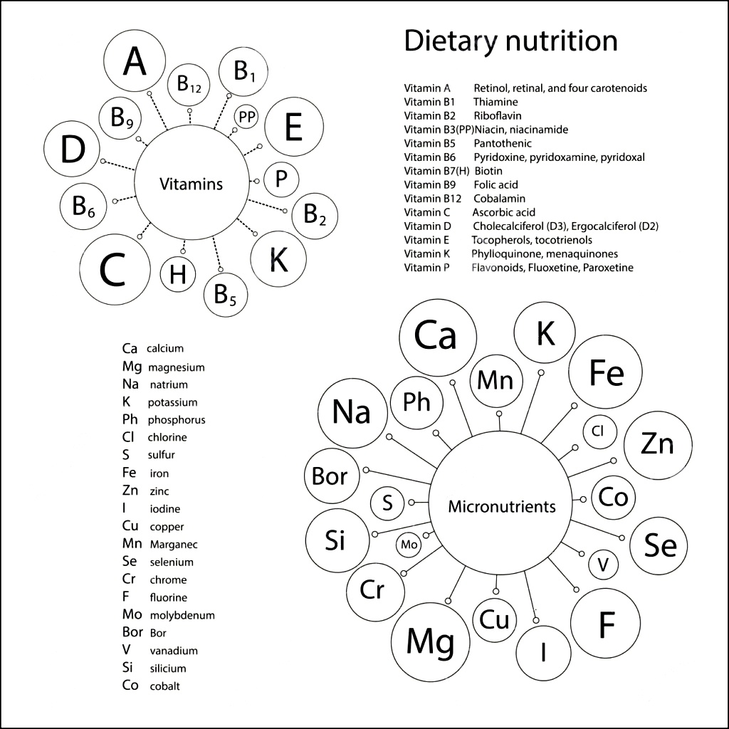

Slide 11
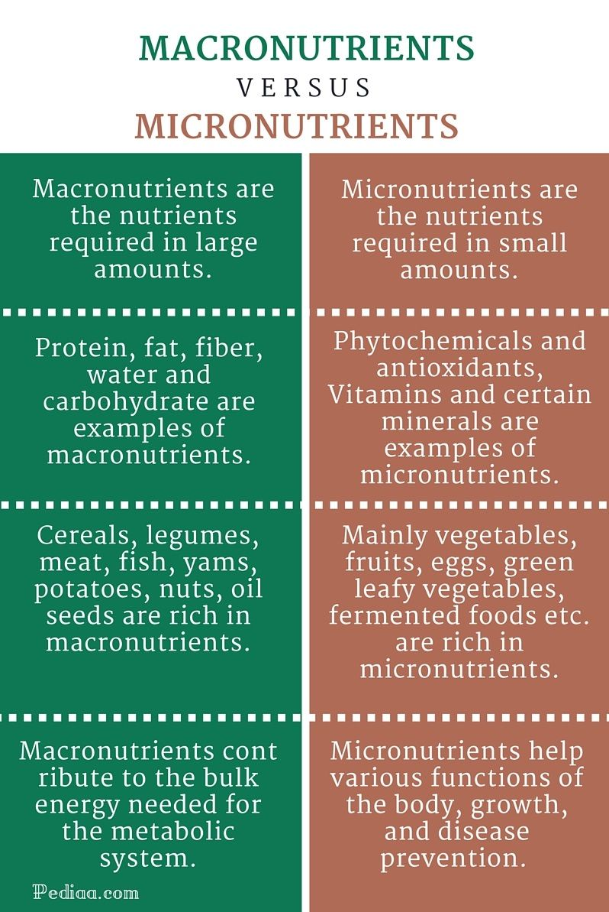

Slide 12
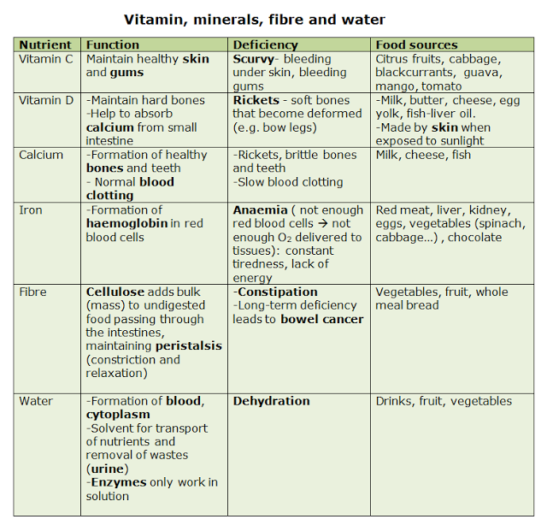

Slide 13
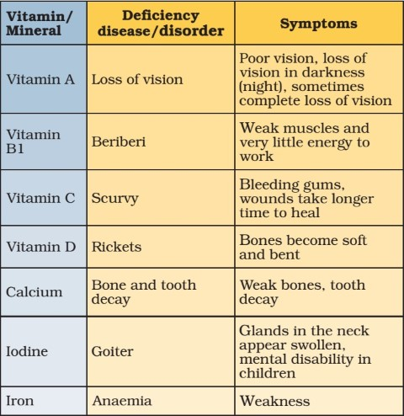

Slide 14
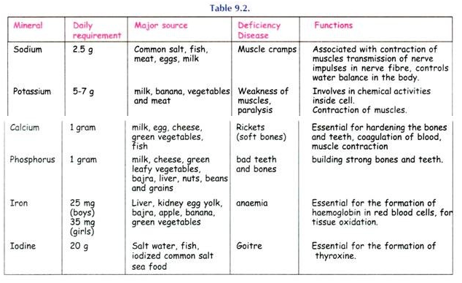

Slide 15
