Slide 1
Anti-idiotypes and Immunity
BY
B PRIYANKA

Slide 2
Anti-idiotypes and Immunity
The immune system of an individual can make millions of different kinds of antibodies:
Each antibody can in turn be the target of other antibodies that recognize its unique molecular characteristics. By means of such antibody-antibody re­actions the immune system interacts with itself.
Networks of reactions seem to modulate the normal immune response, and disorders of the networks may underline autoimmune diseases, such as rheumatoid arthritis, systemic lupus erythematosus and myasthenia gravis, which stem from an immunological attack on the body itself.

Slide 3
These interactions, known as idiotype-anti-idiotype reactions, can be exploited to manipulate the immune system.
There are four such chains in an antibody molecule: two identical heavy, or long, chains flanked by two identical light chains, or shorter segments.
Figure (1) shows a map of the antibody molecule including the regions of idiotype, allotype and isotype.

Slide 4
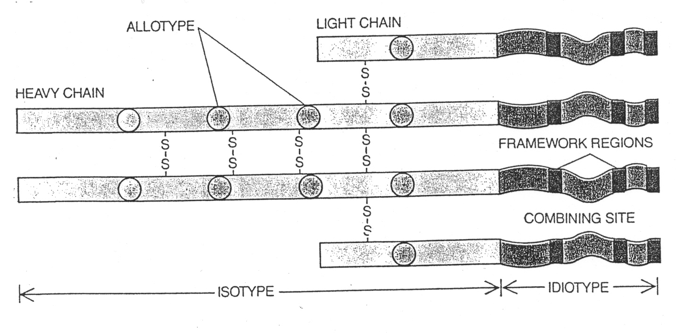

Slide 5
An initial antibody (Ab-1) isolated from the animal’s serum and injected into another animal, will induced a second antibody (Ab-2). The Ab-2 bound only to the Ab-1 and not to other antibodies against which it was tested.
It could therefore be said to recognize the primary antibody’s individuality.
Oudin referred to the unique antigenic determinants on the Ab-1 as its idiotype

Slide 6
For the Ab-2 produced in response to the idiotype he coined the term anti-idiotype.
Other work showed that the immune system can make various kinds of antibodies in response to an Ab- 1.
Some of them bind not only to the Ab-1 that induced them but also to other antibodies with the same class.

Slide 7
Another set of antibodies, called anti-allotypes, react with every antibody made by the individual from which the Ab-1 was taken, although not necessarily with antibodies from other individuals.
An anti-idiotype, in contrast, was defined as an antibody that is able to react only with the Ab-1 elicited by a single antigen.
The idiotype therefore, must lie in the variable region of the antibody.

Slide 8
Purification and absorption of the antibodies
One column has antibodies that bind both allotypic and isotypic antibodies but not the idiotypic antibodies and the preexisting antibodies
Column 2 has antibodies that bound the anti-idiotypic antibodies so when the serum passed through it captures the anti-idiotypic antibodies and let the preexisting antibodies pass through.
Column 2 then flushed with a buffer that elutes the pure form of anti-idiotypic antibodies.

Slide 9
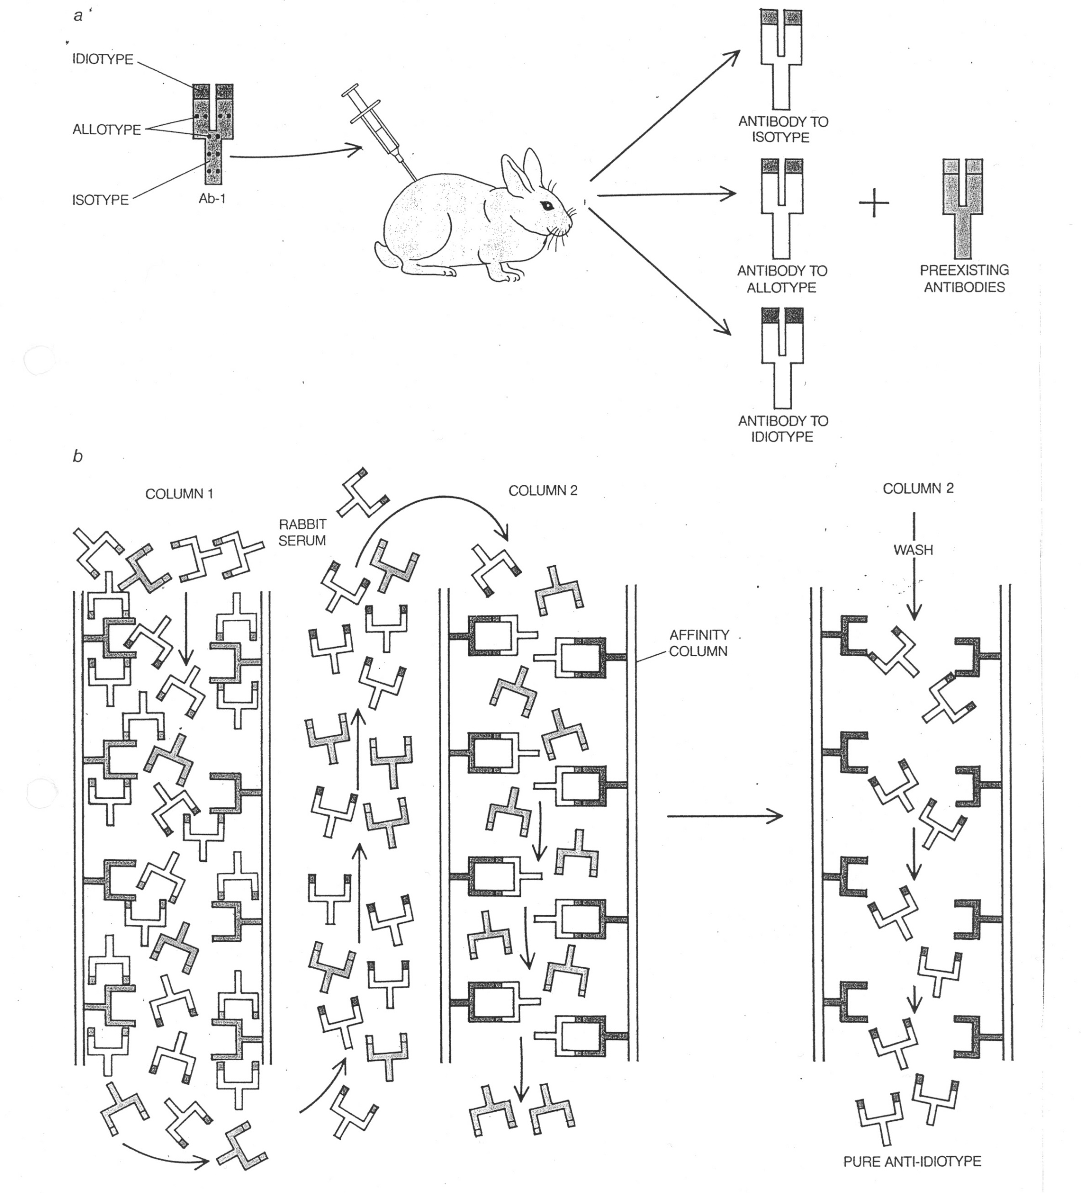

Slide 10
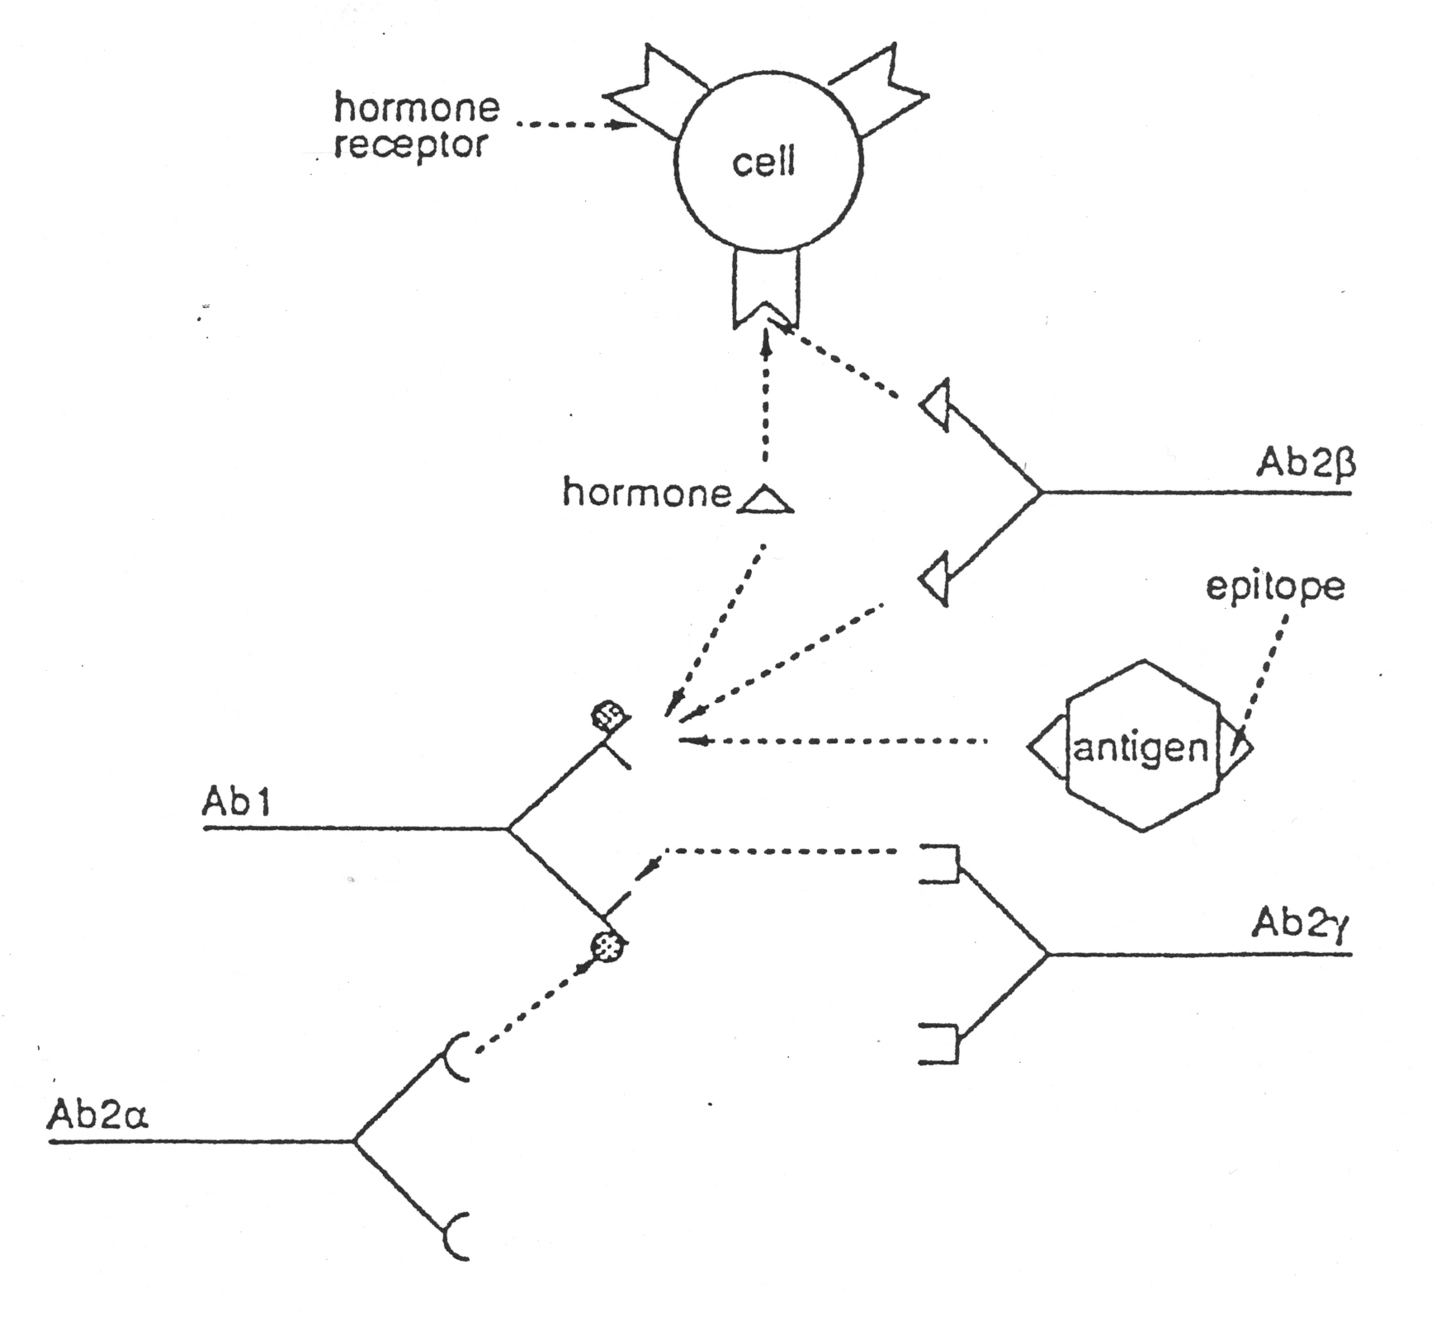

Slide 11
Types of anti-idiotypic antibodies
Ab2α; are set of antibodies that idiotopes distinct from the antigen binding site of Ab-1. The binding of these antibodies to Ab1 does not interfere with the antigen binding capacity of Ab1.
Ab2 β; carries an internal image of the nominal antigen. They constitute about only 15-20 % of the total Ab2. They interfere with binding of the Ag to the Ab1(complete inhibition) . They bear an internal image of the antigen.
Ab2 γ; like the Ab2 β recognizes epitopes within the nominal antigen binding site and can inhibit the binding of Ag to Ab1 but do not bear an internal image of the antigen, thus they partially blocks binding of Ag to Ab1.

Slide 12
Advantages of Anti-idiotypic antibodies
Anti-idiotypic antibodies offer certain advantages over the conventional vaccines;
Ids would eliminate the complications of using killed, attenuated or subunit vaccines thus eliminates the dangers of using these pathogens
A major advantage is their ability to trigger B and T cell immunity. They induce the generation of the T-helper memory cells which results in long lasting immunity. This property may confer immunity on neonates who do not respond to conventional immunotherapy.

Slide 13
Disadvantages
Repeated immunization of humans with heterologous serum proteins lead to the development of serum sickness
Vaccination with anti-idiotypic antibodies may not confer a complete protection and may require subsequent exposure to an antigen.

Slide 14
Thank You

